Slide 1
Without using a calculator, solve the following simultaneous equations:
2x + 3y = 8 and y = 2x
y = 4x – 2 and y = 3x + 1
4y = 3x – 2 and x = y + 3
3x – 5y = 19 and x + y = 9

Slide 2
Simultaneous Equations
Worded Problems

Slide 3
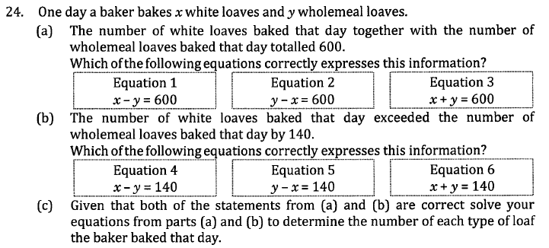

Slide 4


Slide 5
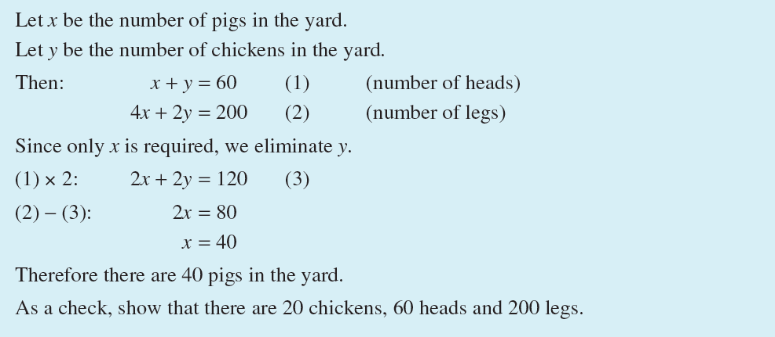

Slide 6
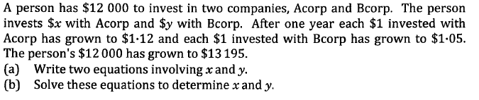

Slide 7
